Slide 1
CS7/8745 : Machine Learning Instructor: Salim Sazzed Department of Computer Science University of Memphis

Slide 2
Evaluation Metrics for Classification and Regression
Nature of the Target Variable:
Regression: In regression tasks, the target variable is continuous and numeric. You are predicting a real-valued quantity, such as house prices, temperature, or age.
Classification: In classification tasks, the target variable is categorical and discrete. You are predicting one of several predefined classes or categories, such as spam or not spam, disease or no disease, etc.

Slide 3
Types of Metrics:
Regression: Common regression metrics include Mean Absolute Error (MAE), Mean Squared Error (MSE), Root Mean Squared Error (RMSE), R-squared (R²), and others. These metrics focus on measuring the accuracy and precision of the predicted numeric values compared to the actual values.
Classification: Common classification metrics include Accuracy, Precision, Recall, F1 Score, etc. These metrics assess the model's ability to classify instances into different classes and the trade-offs between true positives, true negatives, false positives, and false negatives.

Slide 4
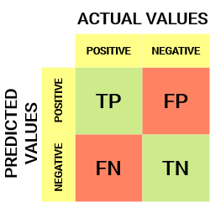
Confusion Matrix for Classification
A confusion matrix is a table or a matrix that is often used to assess the performance of a classification machine learning model.
Actual value = true value
Predicted value = prediction from model
True Positives (TP): These are instances that the model correctly predicted as positive
True Negatives (TN): These are instances that the model correctly predicted as negative
False Positives (FP): These are instances that the model incorrectly predicted as positive when they were actually negative
False Negatives (FN): These are instances that the model incorrectly predicted as negative when they were actually positive

Slide 5
2-class classification problem
Sample | Actual value | Prediction
1 | 0 | 1
2 | 1 | 1
3 | 1 | 1
4 | 1 | 1
5 | 1 | 0
6 | 0 | 1
7 | 0 | 0
8 | 1 | 1
9 | 0 | 0
10 | 1 | 0
We have 10 samples representing two classes, 0 (negative) and 1 (positive).
TP = positive value for both ground truth and prediction
TN = negative value for both ground truth and prediction
FP = = negative value for ground truth but positive value for prediction
FN = positive ground truth value but predictions says negative
TP = 4
TN = 2
FP = 2
FN = 2

Slide 6
Sample | Actual value | Prediction
1 | 0 | 1
2 | 1 | 1
3 | 1 | 1
4 | 1 | 1
5 | 1 | 0
6 | 0 | 1
7 | 0 | 0
8 | 1 | 1
9 | 0 | 0
10 | 1 | 0
11 | 1 | 1
12 | 0 | 1
13 | 1 | 1
true positive (TP), true negative (TN), false positive (FP), and false negative (FN) and accuracy
Accuracy measures the proportion of correctly classified instances in a classification task.
Accuracy = (TP + TN) / (TP + TN + FP + FN)

Slide 7
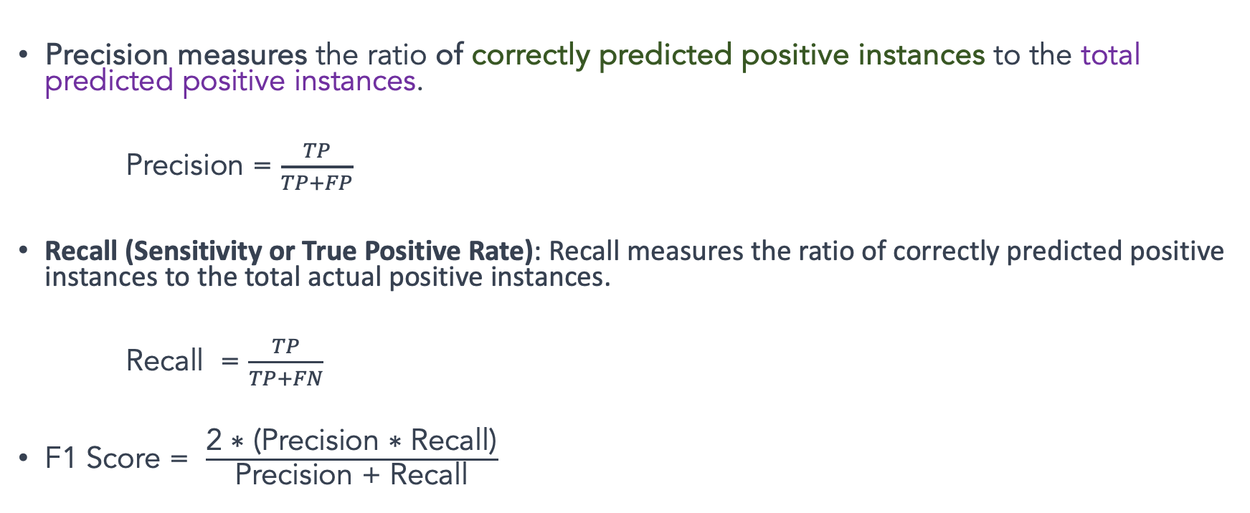
Precision, Recall, and F1 score
Precision measures the ratio of correctly predicted positive instances to the total predicted positive instances.
Precision = $\frac{TP}{TP+FP}$
Recall (Sensitivity or True Positive Rate): Recall measures the ratio of correctly predicted positive instances to the total actual positive instances.
Recall = $\frac{TP}{TP+FN}$
F1 Score = $\frac{\text{2 ∗ (}\text{Precision}\text{ ∗ }\text{Recall}\text{)}}{\text{Precision}\text{ + }\text{Recall}}$

Slide 8
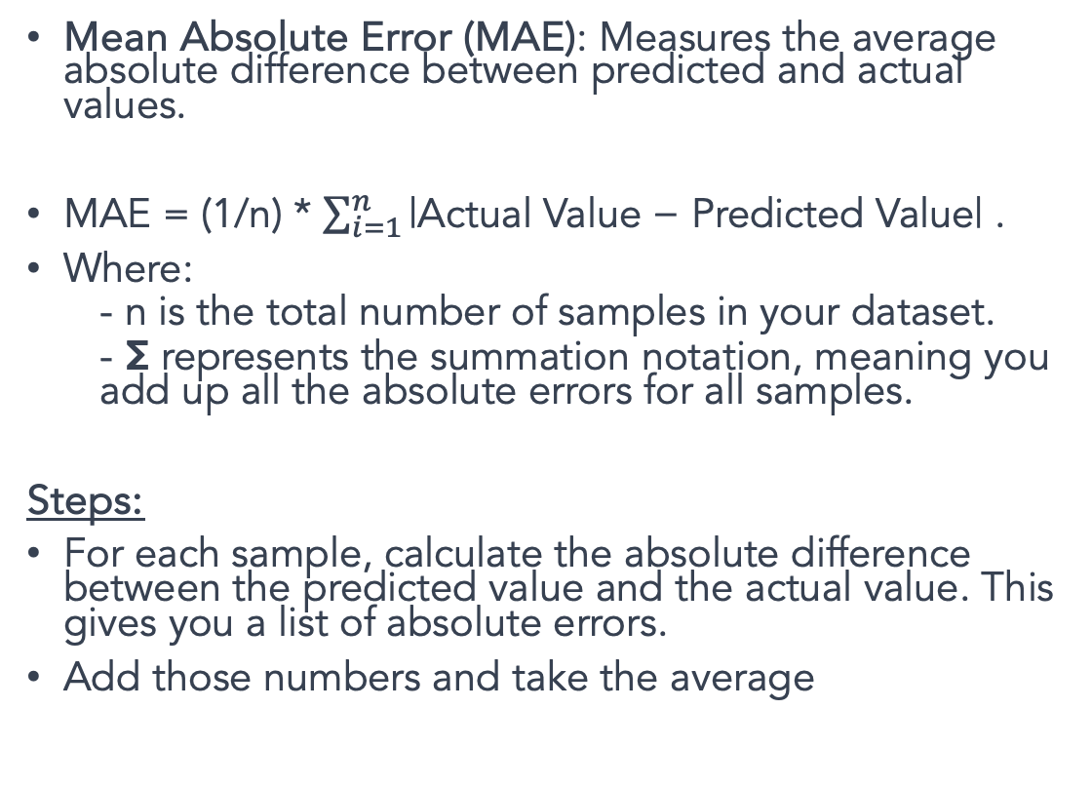
Metrics for Regression
Sample | Actual value | Prediction
1 | 5 | 3
2 | 4 | 6
3 | 3 | 9
4 | 2 | 0
5 | 7 | -5
6 | 2 | -1
7 | 4 | 0
8 | -3 | -1
9 | 3 | 3
10 | 4 | 6
Mean Absolute Error (MAE): Measures the average absolute difference between predicted and actual values.
MAE = (1/n) * $\sum_{i=1}^{n}{\text{|}\text{Actual} \text{Value}\text{ − }\text{Predicted} \text{Value}\text{| }}$.
Where:
- n is the total number of samples in your dataset.
- Σ represents the summation notation, meaning you add up all the absolute errors for all samples.
Steps:
For each sample, calculate the absolute difference between the predicted value and the actual value. This gives you a list of absolute errors.
Add those numbers and take the average

Slide 9
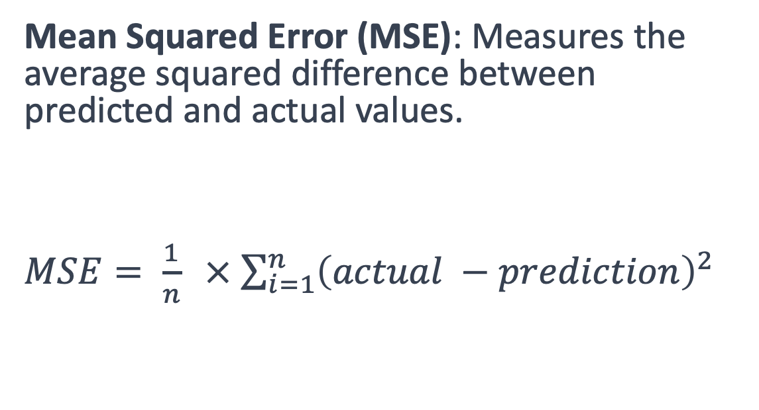
Sample | Actual value | Prediction
1 | 5 | 3
2 | 4 | 6
3 | 3 | 9
4 | 2 | 0
5 | 7 | -5
6 | 2 | -1
7 | 4 | 0
8 | -3 | -1
9 | 3 | 3
10 | 4 | 6
Mean Squared Error (MSE): Measures the average squared difference between predicted and actual values.
$MSE= \frac{1}{n} ×$ $\sum_{i=1}^{n}{{\left(actual −prediction\right)}^{2}}$

Slide 10
Decision Tree

Slide 11
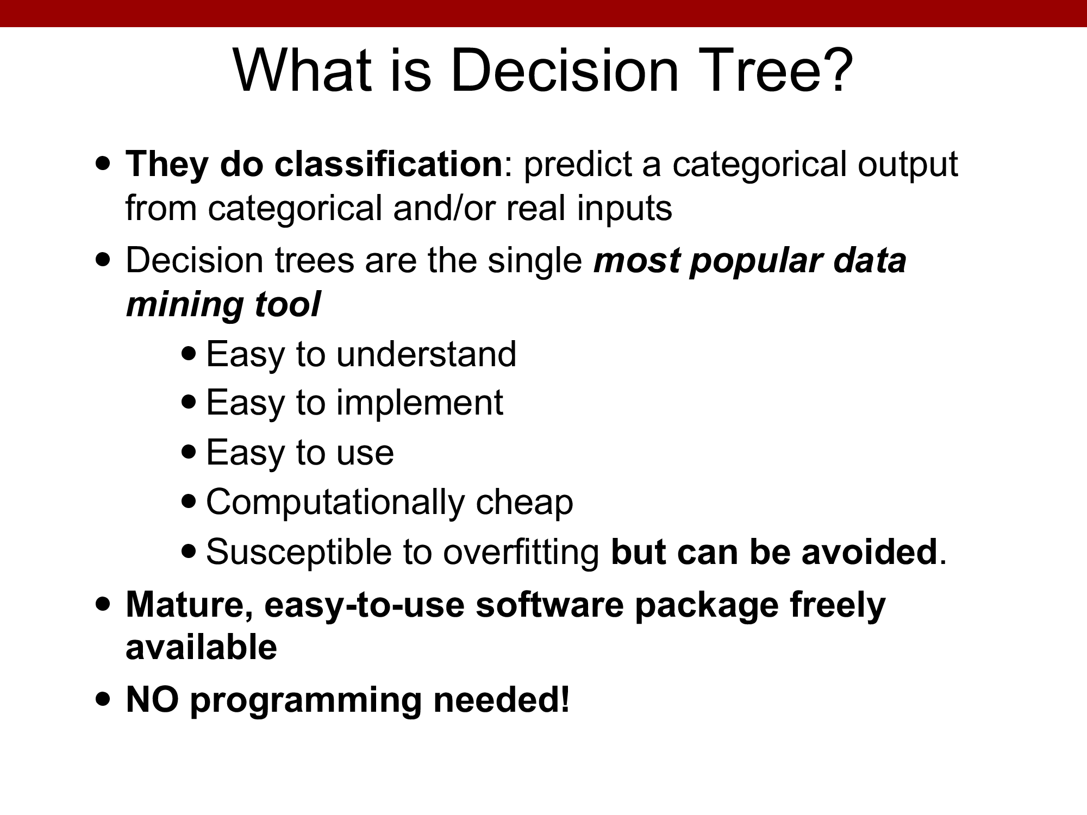

Slide 12
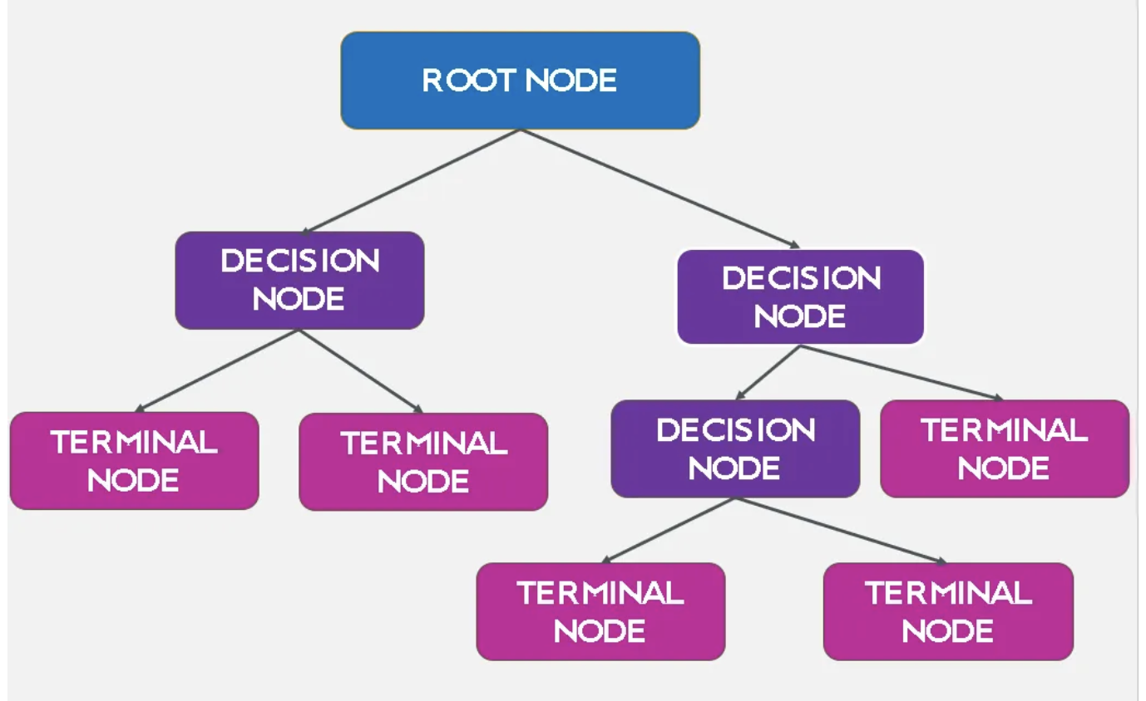
Structure of a Decision Tree
https://medium.com/

Slide 13
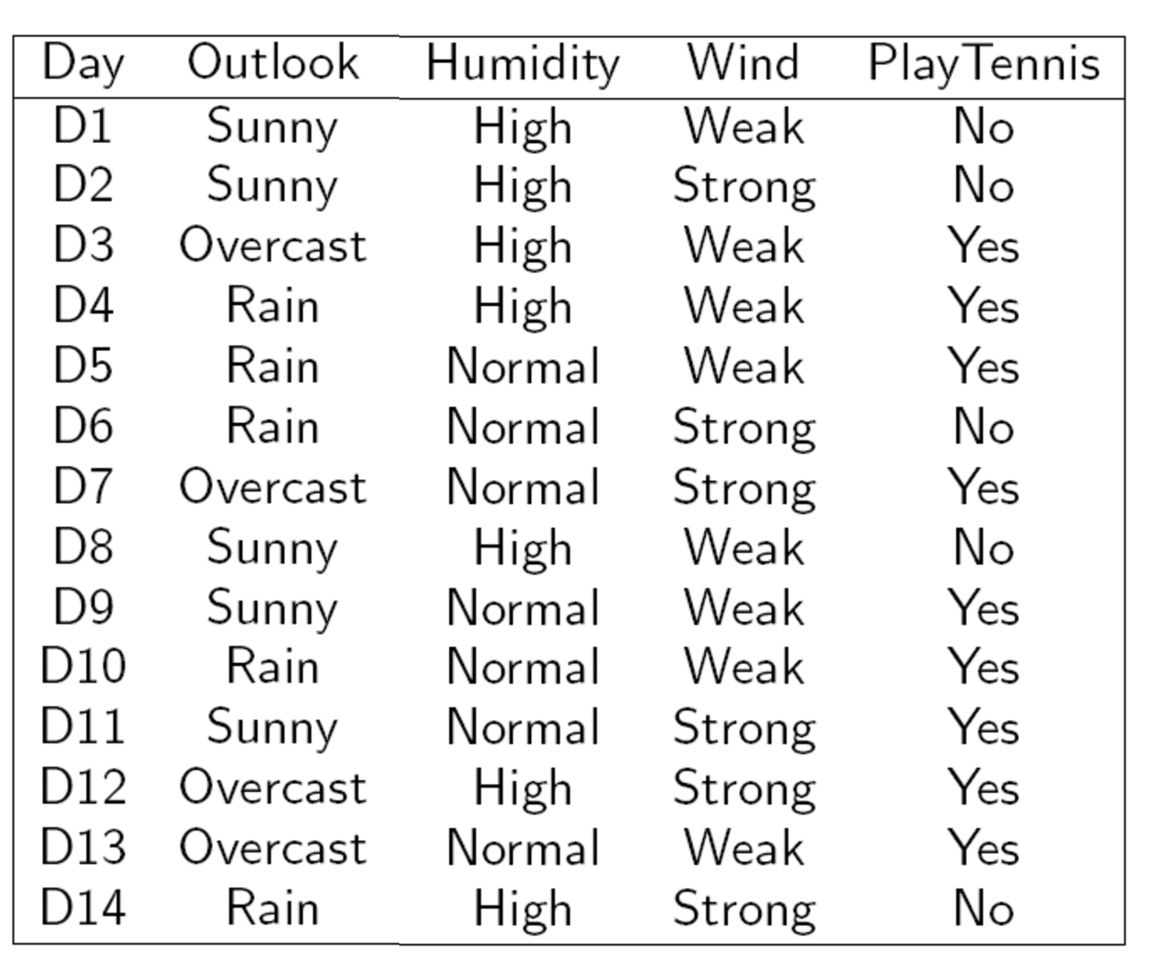
Target
14 samples
Each column represent one feature
Three Feature/Attributes

Slide 14
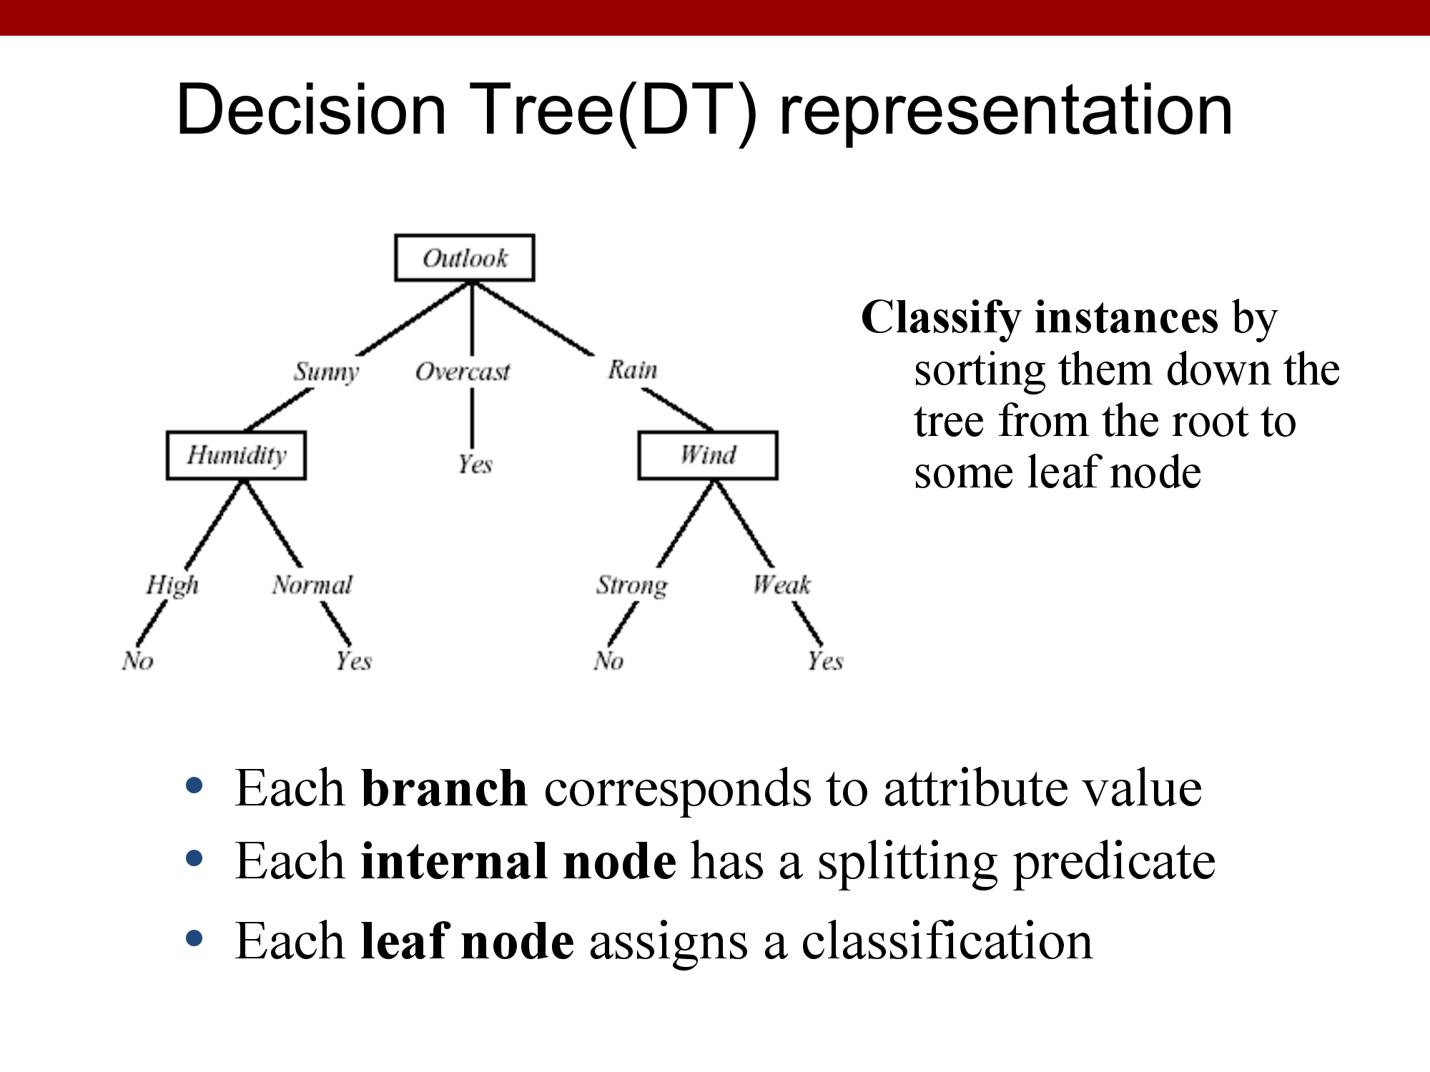
Internal node = Attribute/Feature
Branches = number of attribute/feature
Leaf = Target

Slide 15
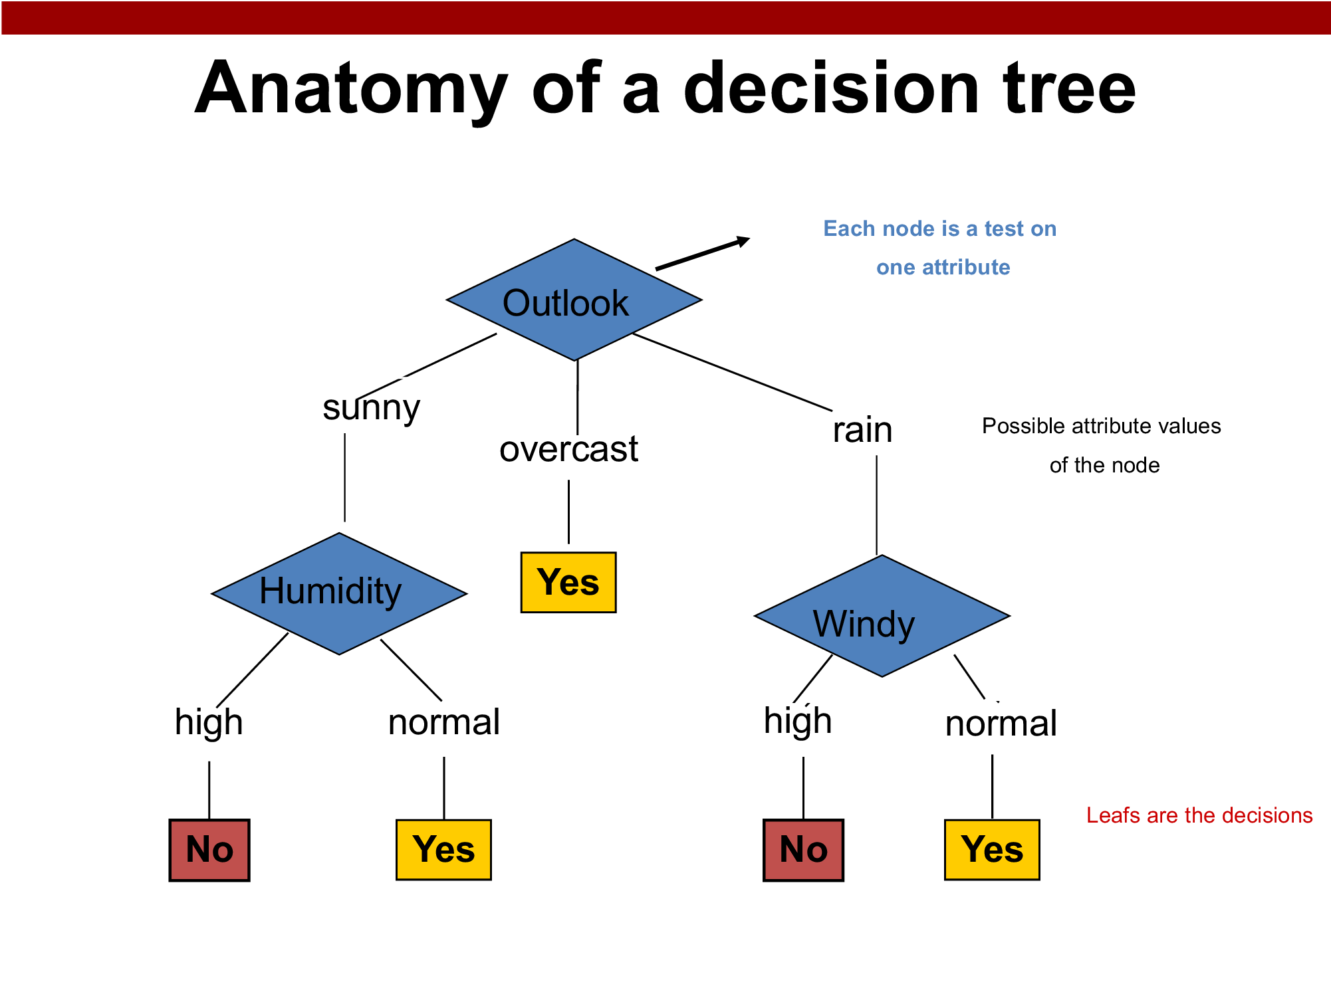

Slide 16
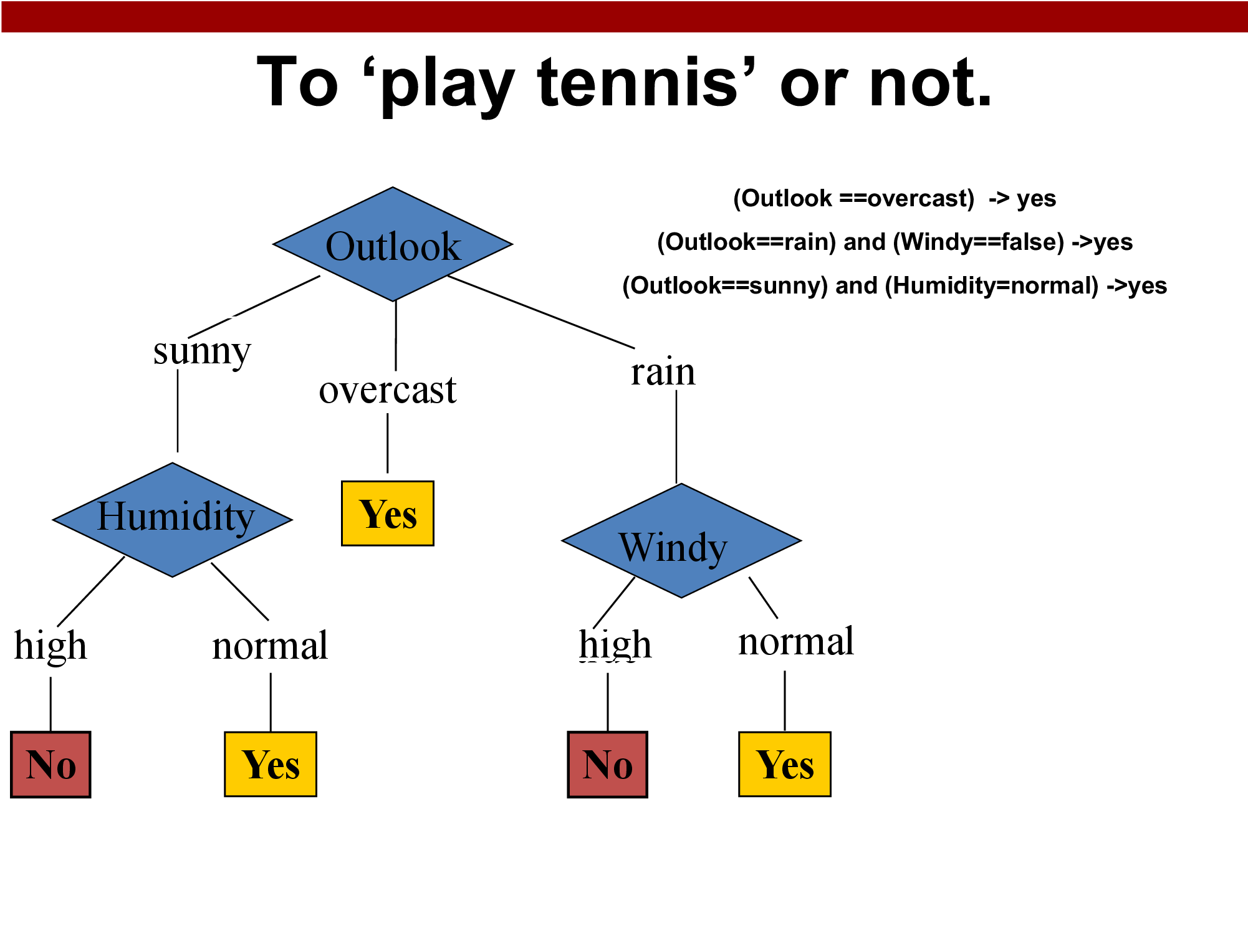
What rules this decision tree indicates?

Slide 17
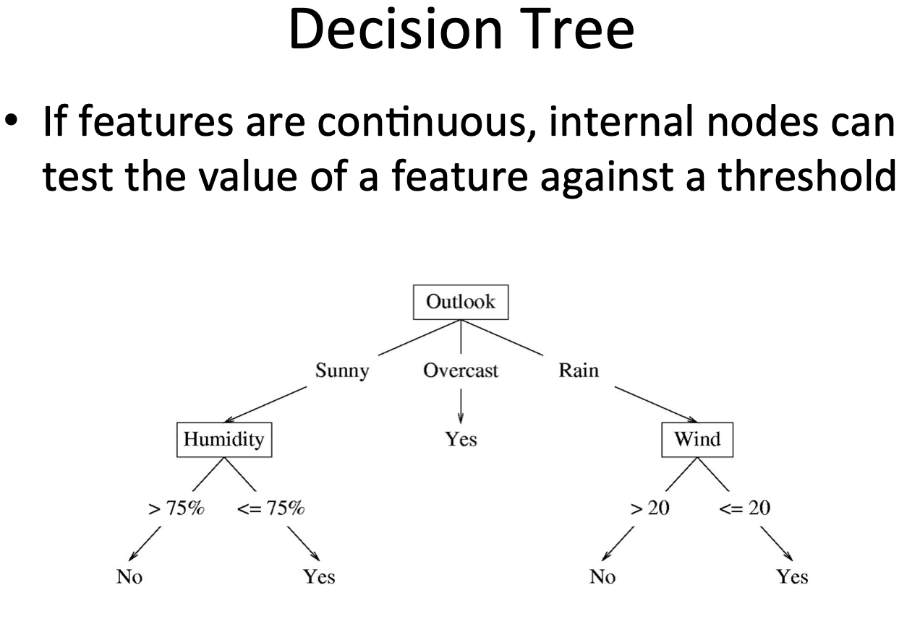

Slide 18
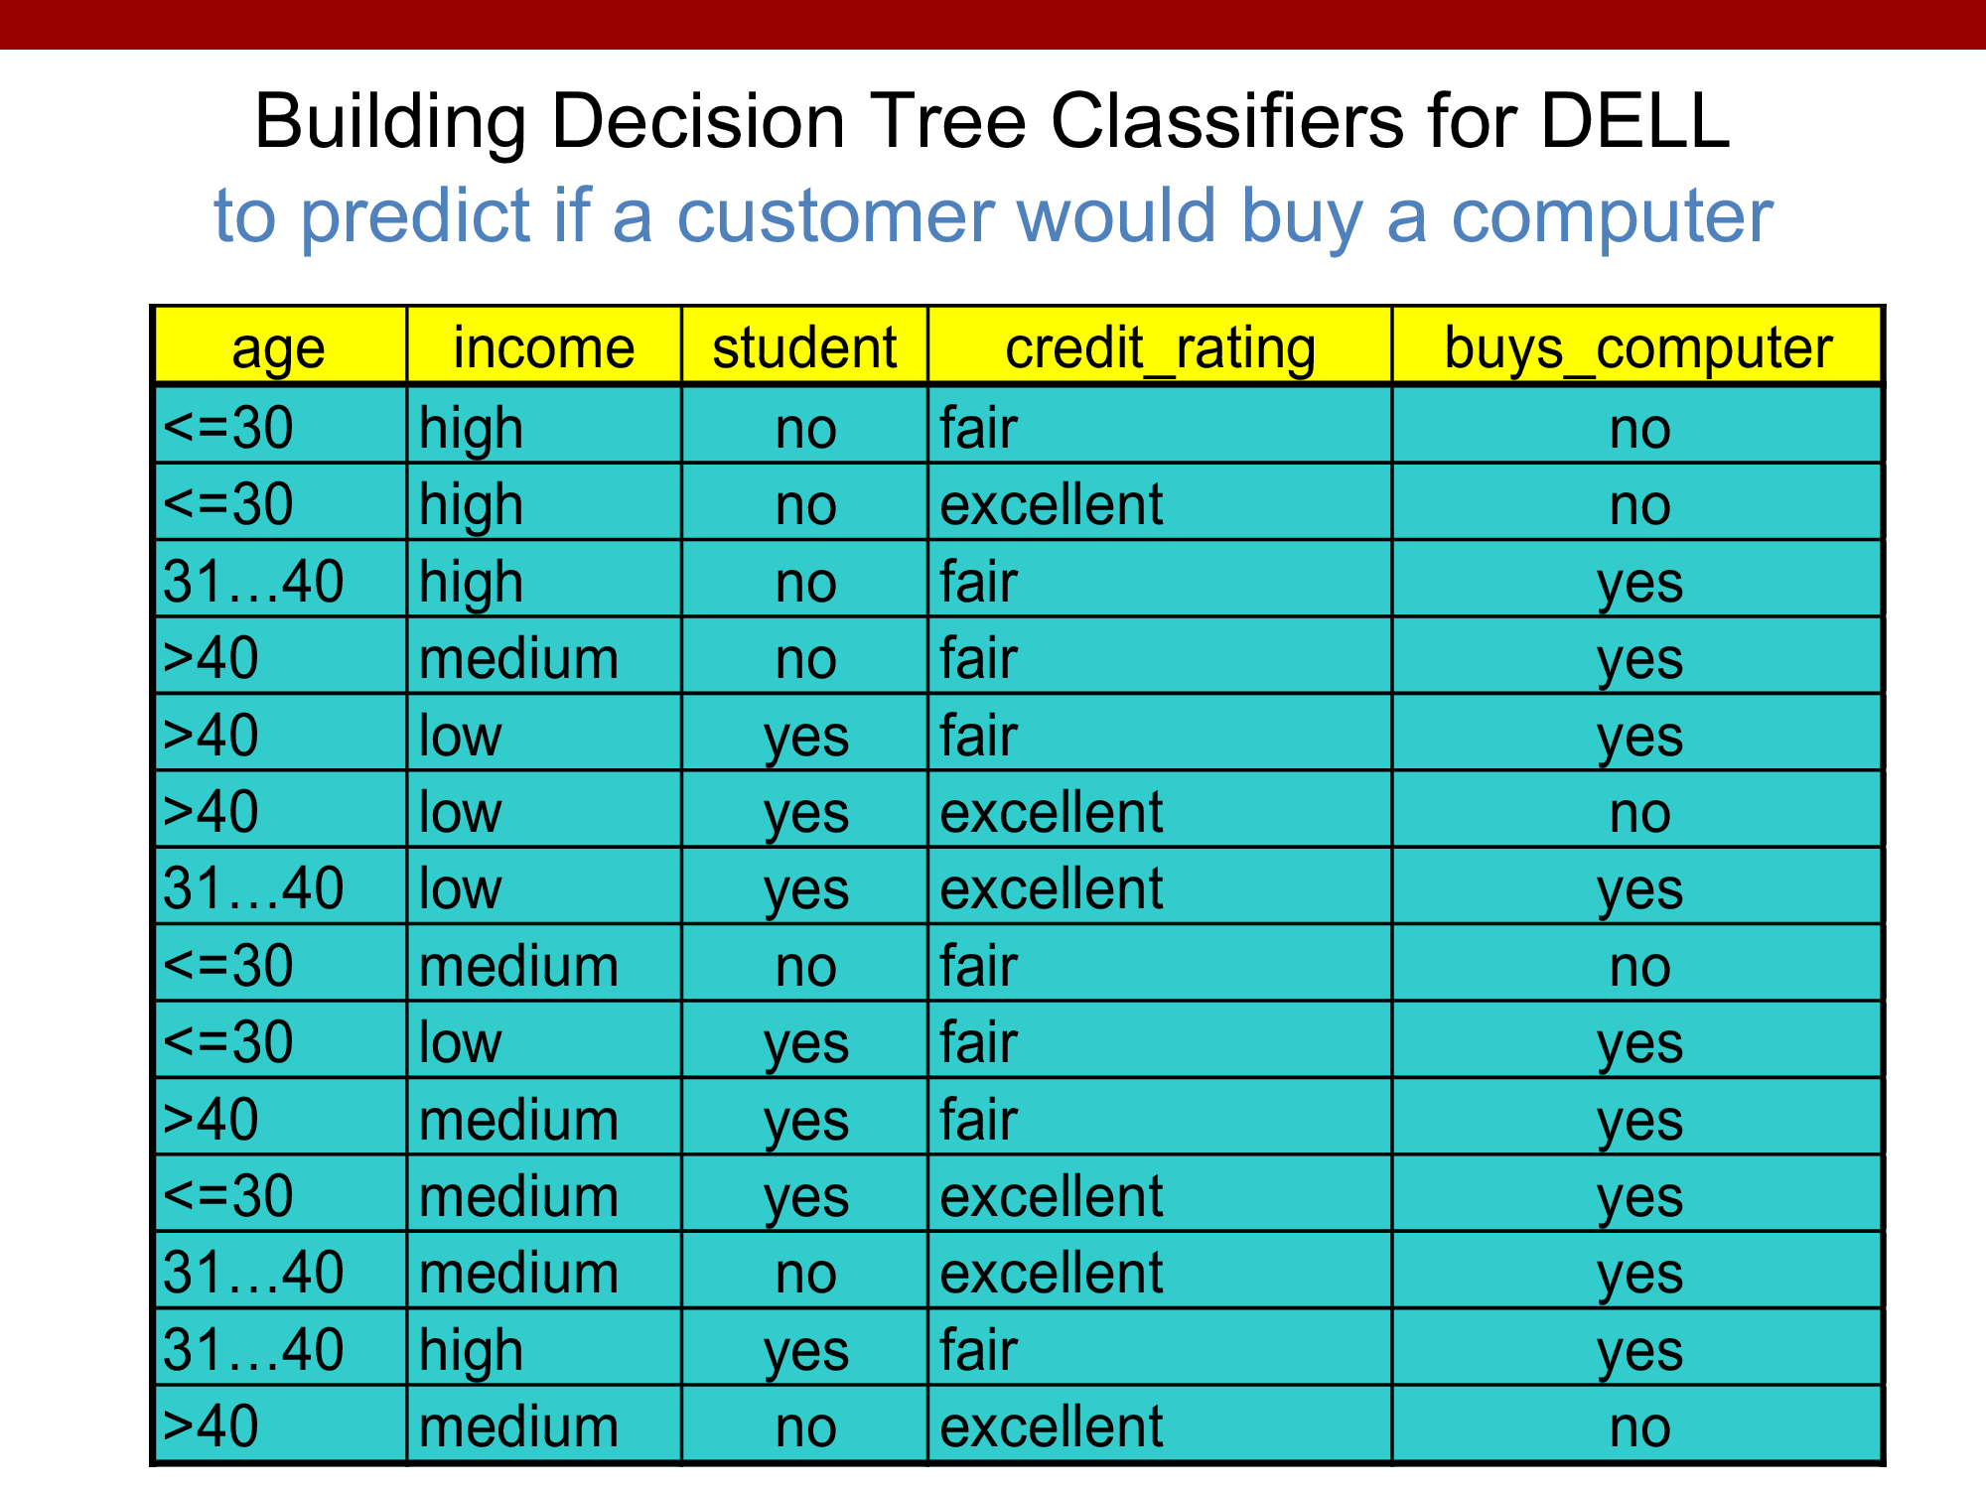

Slide 19
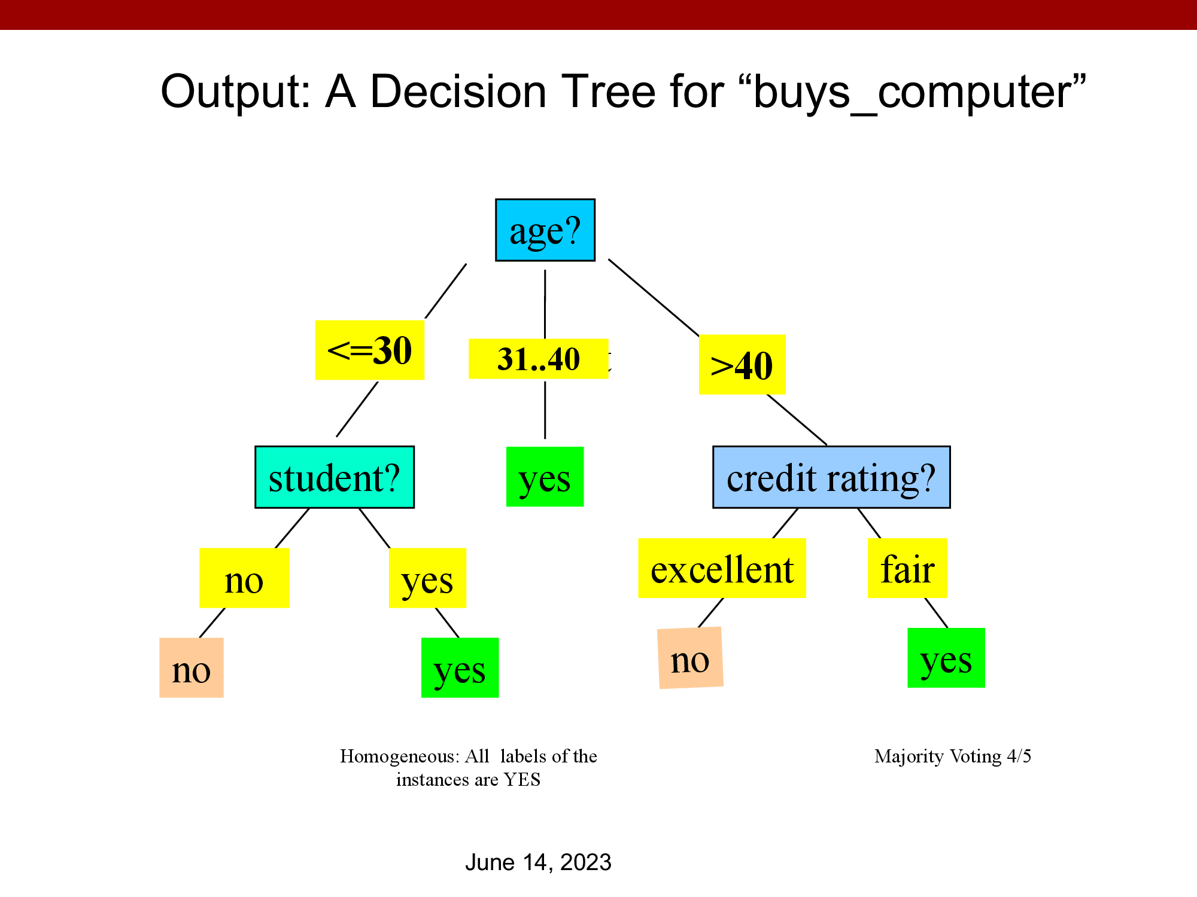

Slide 20
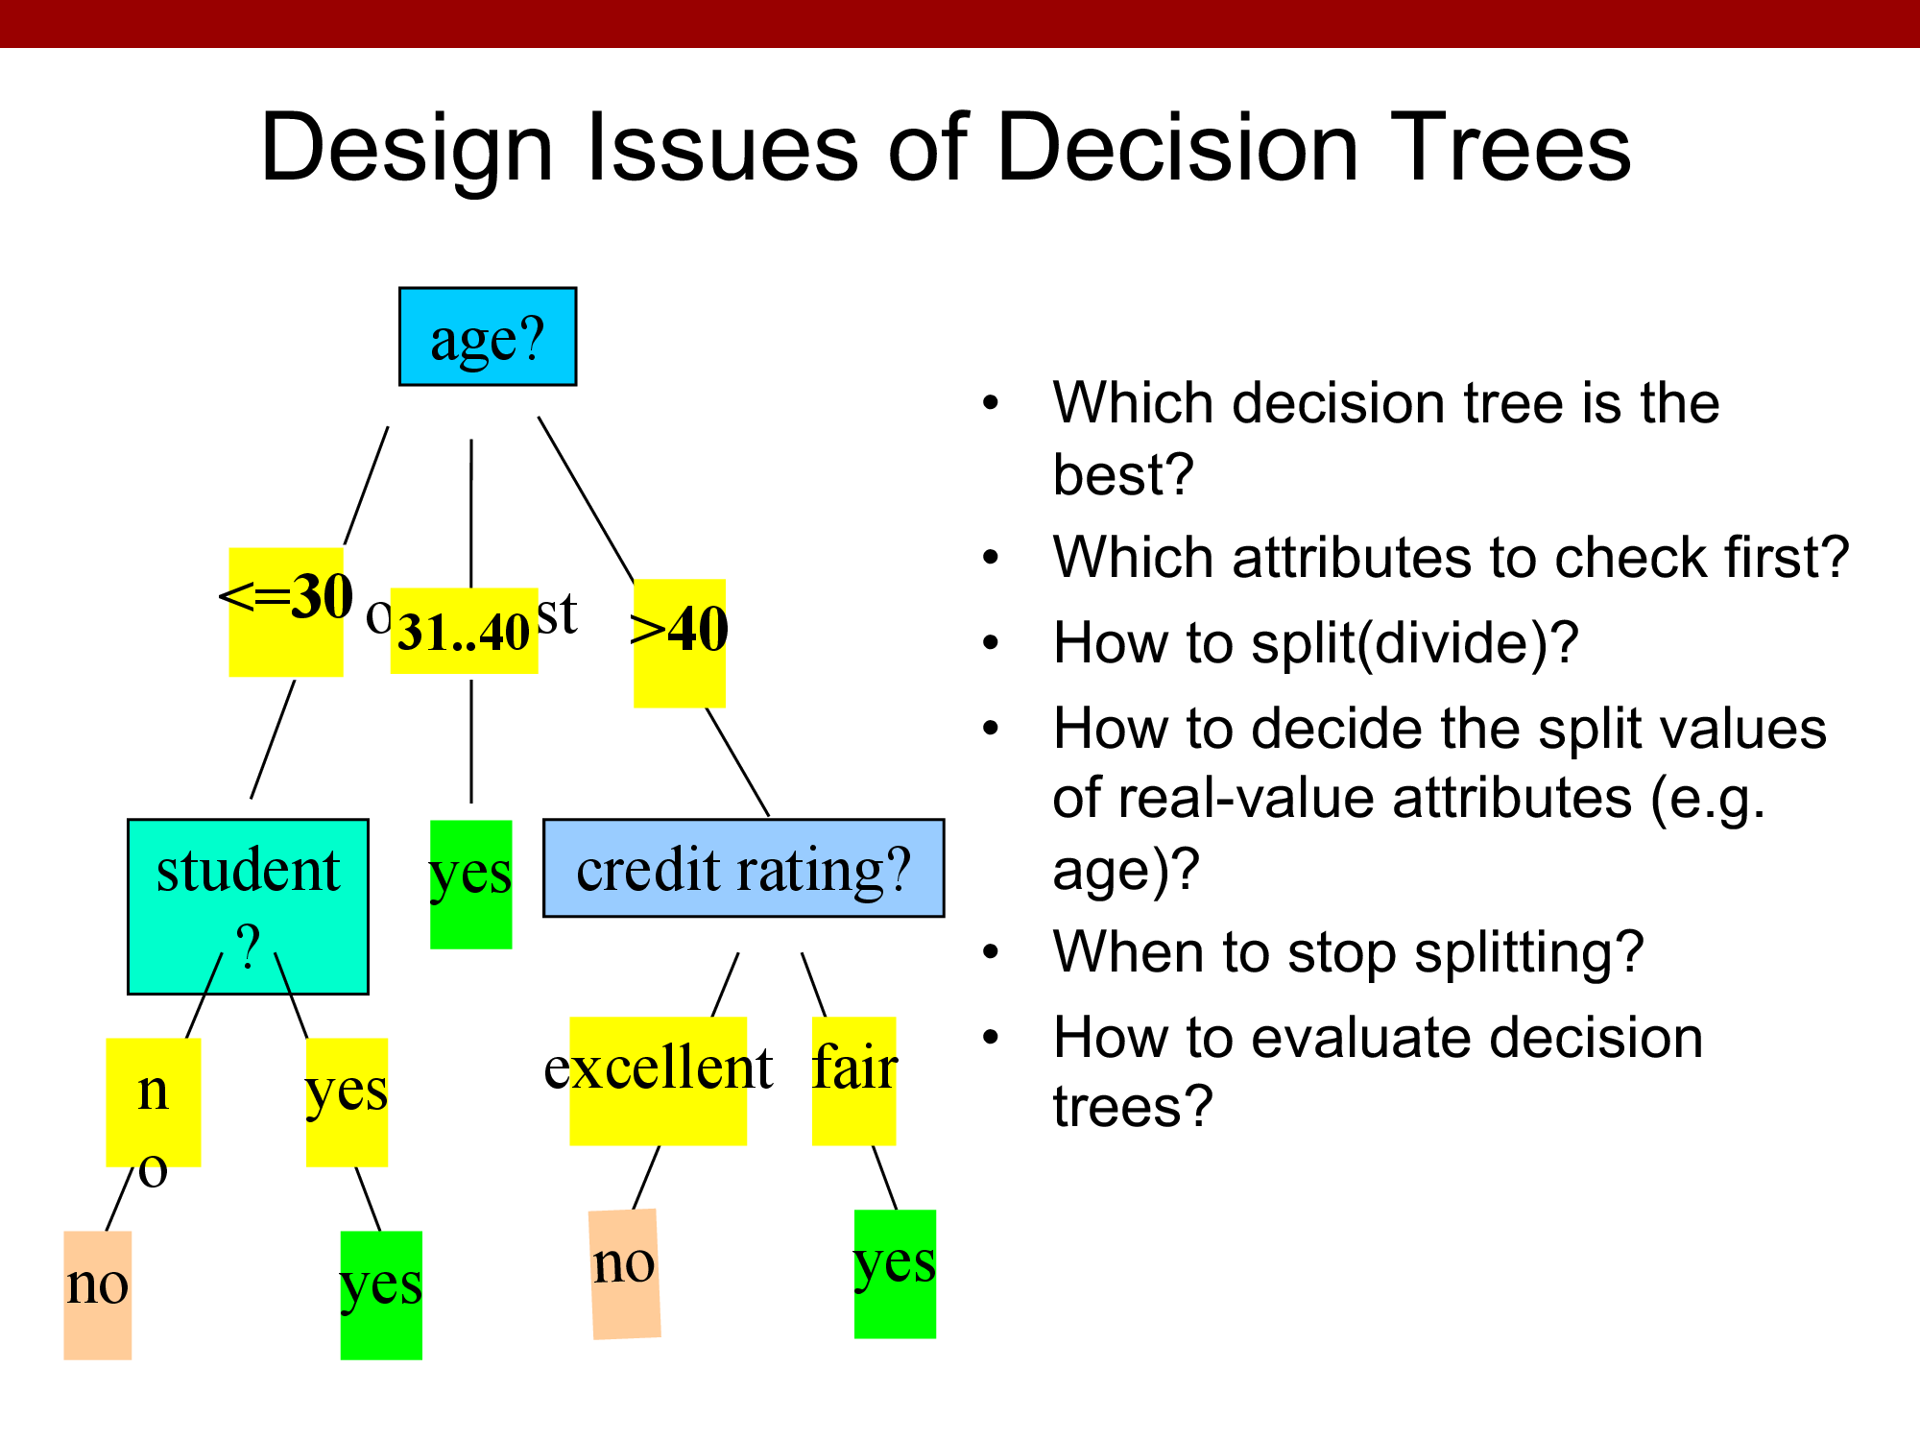

Slide 21
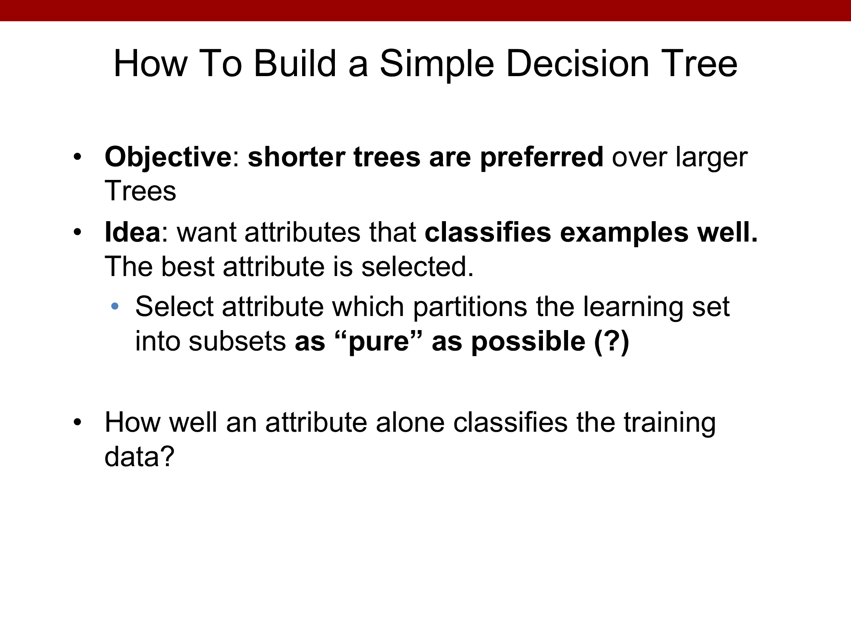

Slide 22
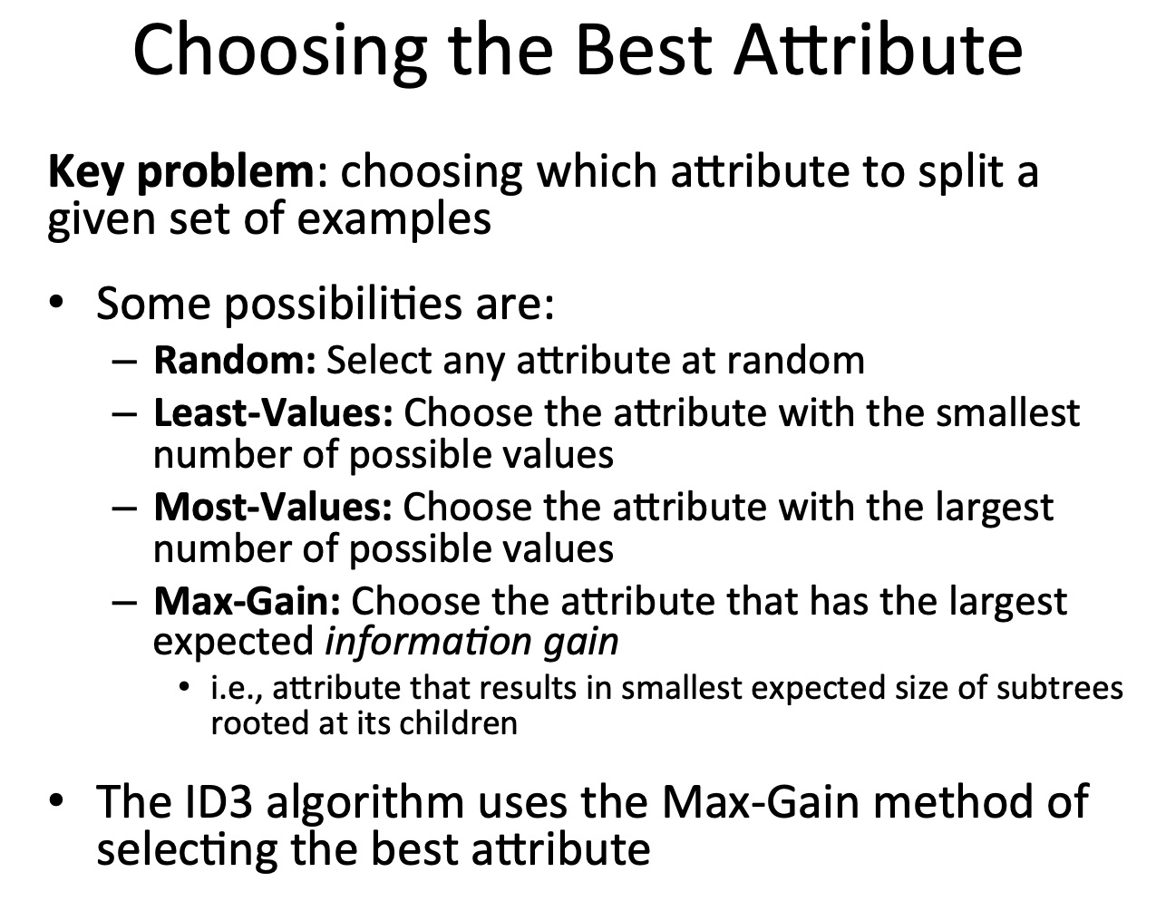

Slide 23
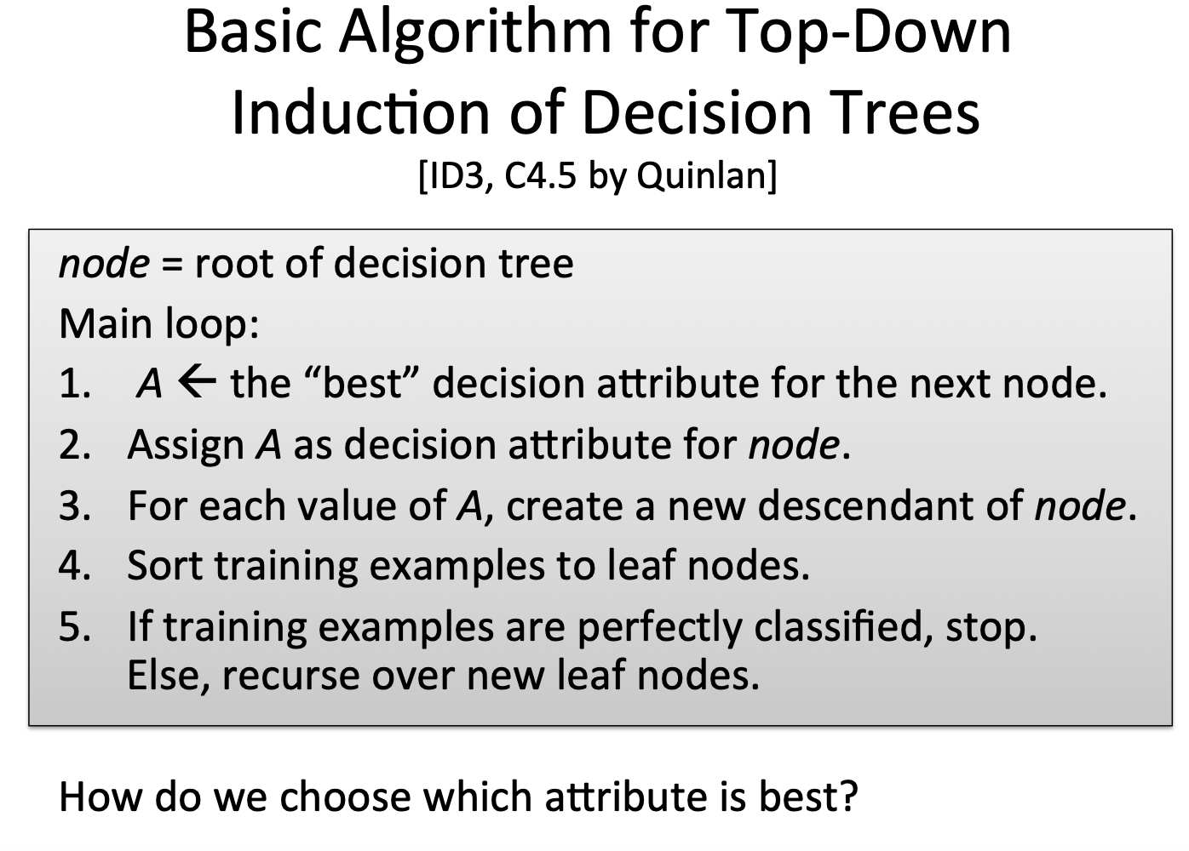

Slide 24
Entropy
In the context of Decision Trees, entropy is a measure of disorder or impurity in a node.
Thus, a node with more variable composition (multiple types) to have higher Entropy than a node which has only single type value.
The maximum level of entropy or disorder is given by 1 and minimum entropy is given by a value 0.

Slide 25
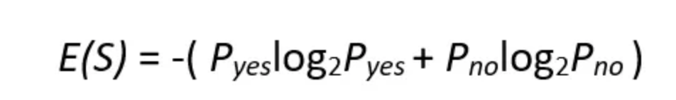
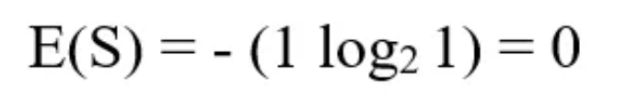
If we have a dataset of 10 observations belonging to two classes YES and NO. If 6 observations belong to the class, YES, and 4 observations belong to class NO, then entropy can be written as below.
P_{yes} is the probability of choosing YES and P_{no} is the probability of choosing a NO.
Here P_{yes} is 6/10 and P_{no} is 4/10.
If all the 10 observations belong to 1 class then entropy will be equal to zero. Which implies the node is a pure node.

Slide 26
If both classes YES and NO have an equal number of observations, then entropy will be equal to 1

